Slide 1

CSC 2302/DSCI 1302 Object Oriented Programming (cont.)
- S M Towhidul Islam

Slide 2
The ‘self’ parameter
It represents the caller object/instance
Helps to access instance methods
smallCircle = Circle()
smallCircle.setRadius(1) # self is passed implicitly
# Equivalent to:
# Circle.setRadius(smallCircle, 1)
largeCircle = Circle()
largeCircle.setRadius(100) # Again, self is passed implicitly
#Equivalent to: Circle.setRaidus(largeCircle, 100)
class Circle: def __init__(self): self.radius = 0
def setRadius(self, r): self.radius = r
def getRadius(self): return self.radius

Slide 3
The ‘self’ parameter
smallCircle = Circle()
smallCircle.setRadius(1) # self is passed implicitly
# Equivalent to:
# Circle.setRadius(smallCircle, 1)
largeCircle = Circle()
largeCircle.setRadius(100) # Again, self is passed implicitly
#Equivalent to: Circle.setRaidus(largeCircle, 100)
print(smallCircle.getRadius()) # self is passed implicitly
#Equivalent to: Circle.getRadius(smallCircle)
class Circle: def __init__(self): self.radius = 0
def setRadius(self, r): self.radius = r
def getRadius(self): return self.radius

Slide 4

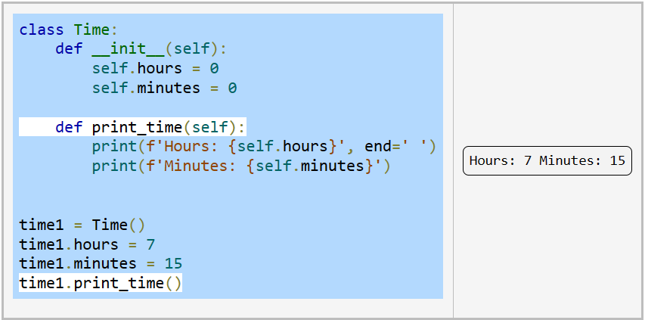
Classes: Instance Method
What will be printed if we move the last line of code?

Slide 5
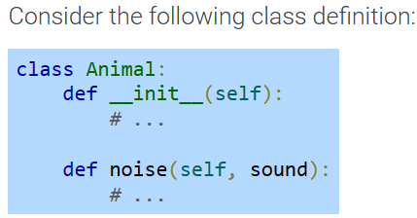

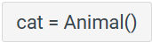

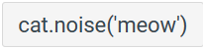
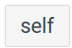



Classes: Instance Method

Slide 6

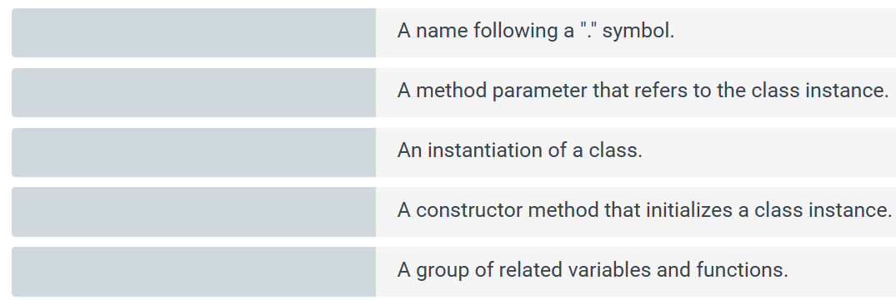
attribute
self
instance
__init__
class

Slide 7
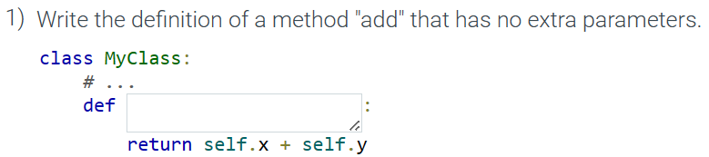

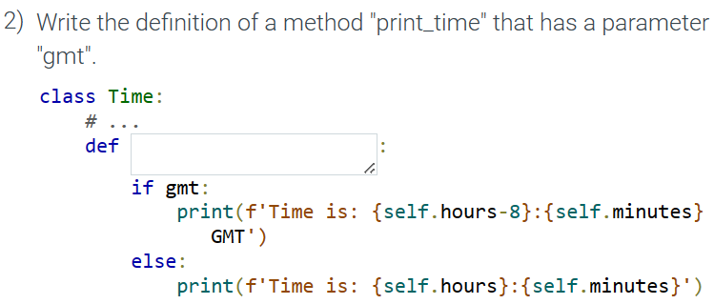

Classes: Instance Method

Slide 8
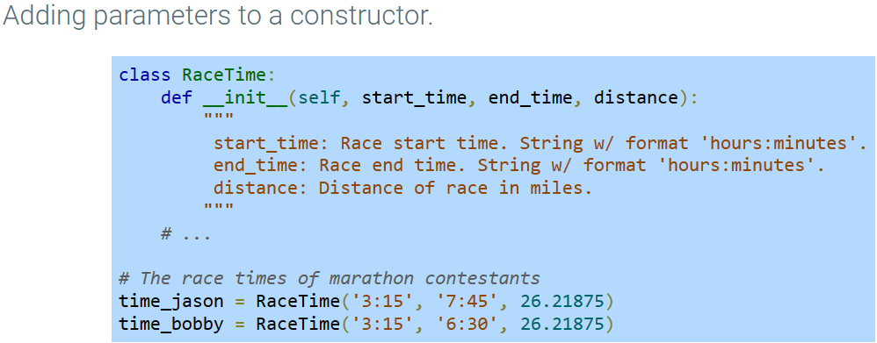
Class Constructors

Slide 9
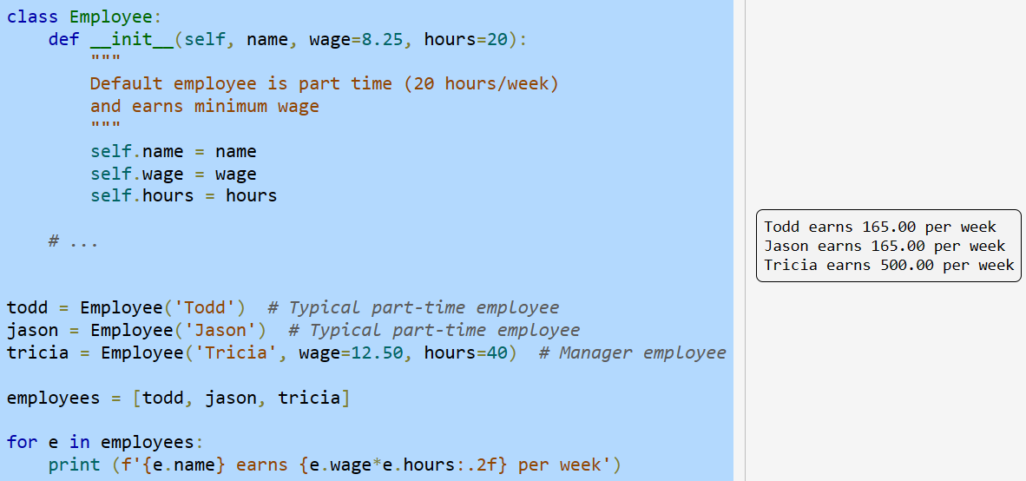
Constructor Default Parameters

Slide 10
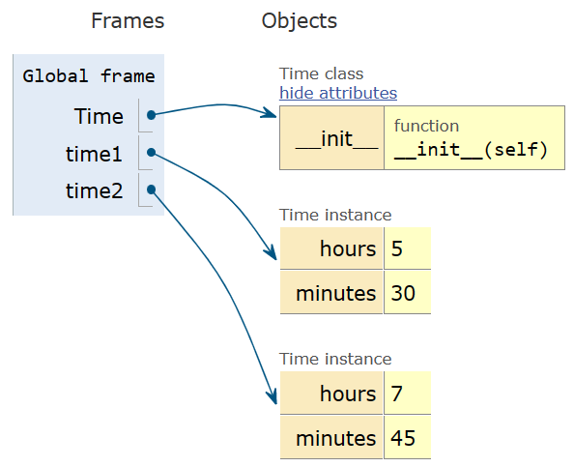
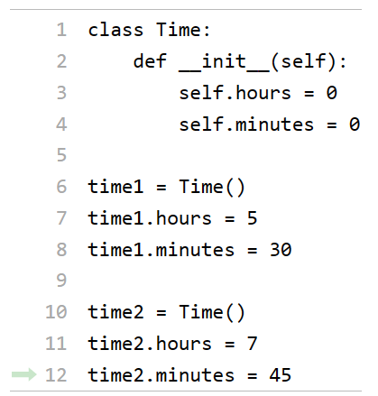
Class and Object instance types

Slide 11
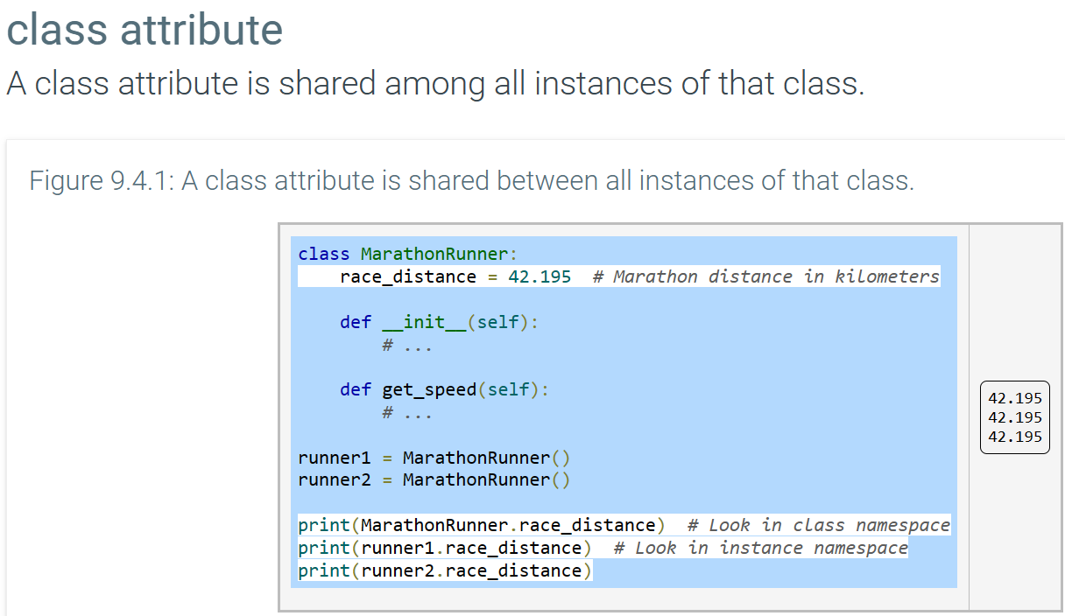
Class and Object instance types
Changing a class attribute affects behavior of all instances.

Slide 12
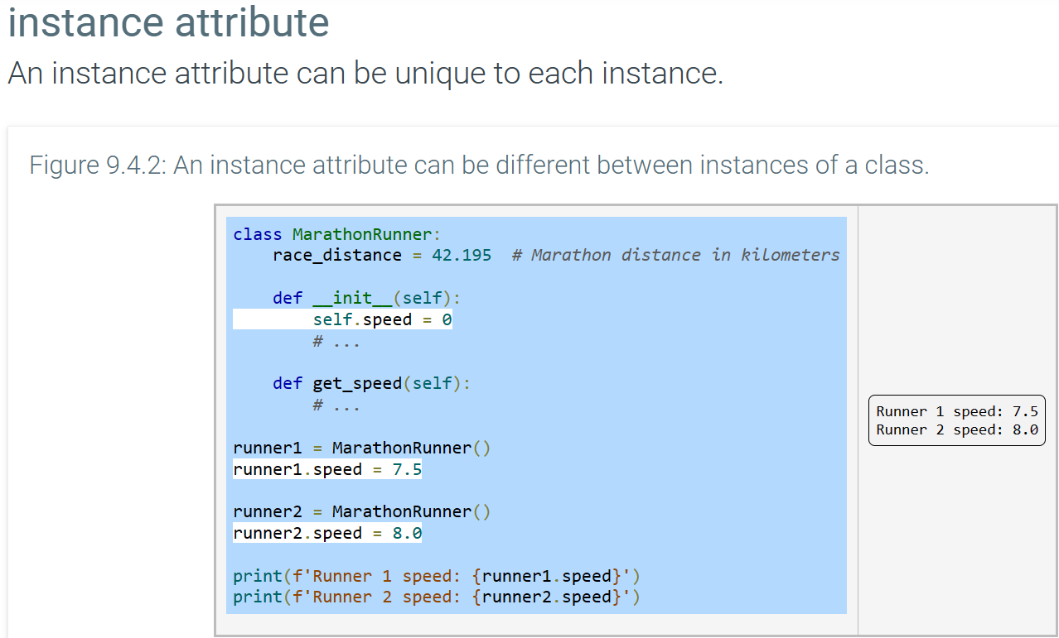
Class and Object instance types

Slide 13
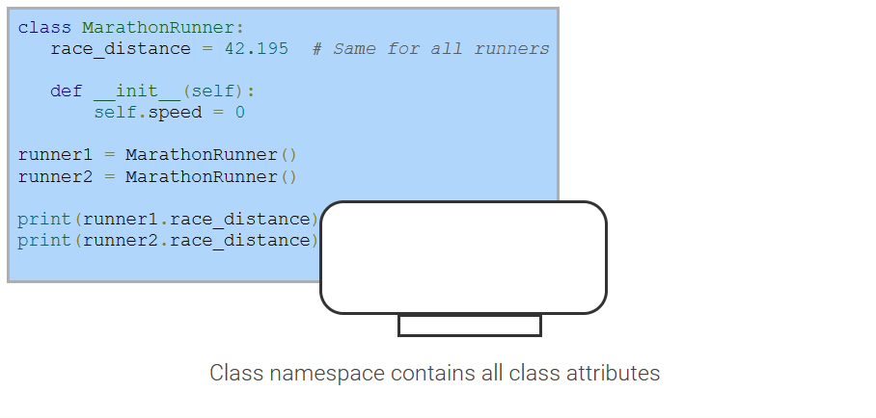
Class and Object instance types

Slide 14
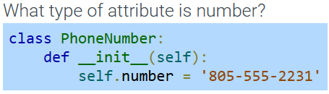
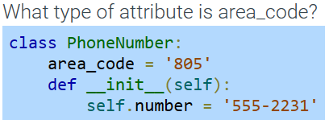
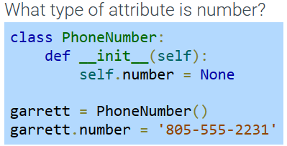

Slide 15
Suggested Reading (ZyBooks):
9.3 Classes: Instance Methods
9.4 Classes: Class and Instance Object Types

Slide 16
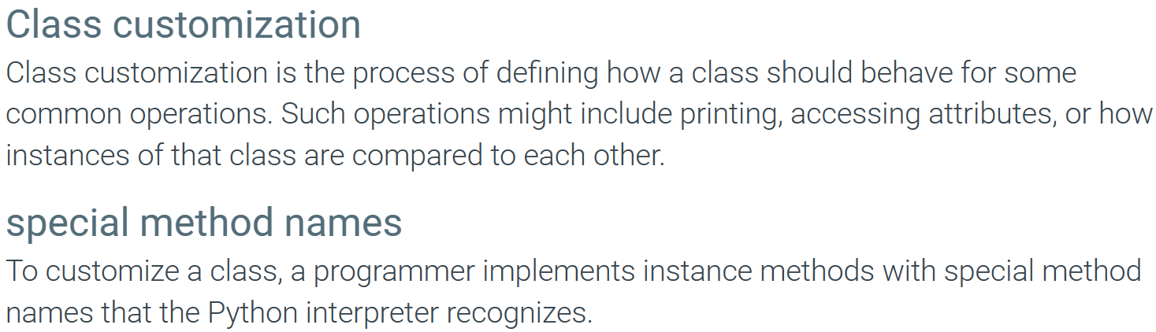
Class Customization

Slide 17
Class Customization

Slide 18
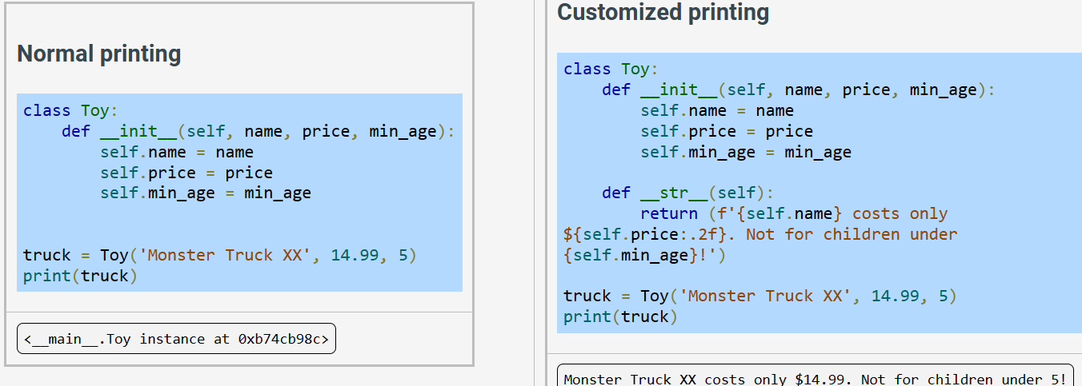
Class Customization

Slide 19
Polymorphism: - Operator/Method overloading

Slide 20
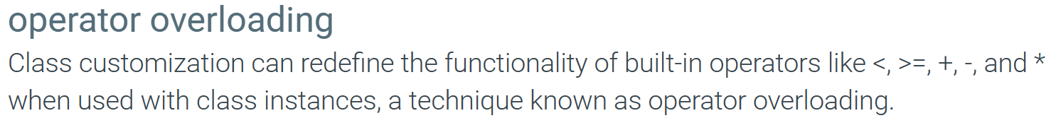
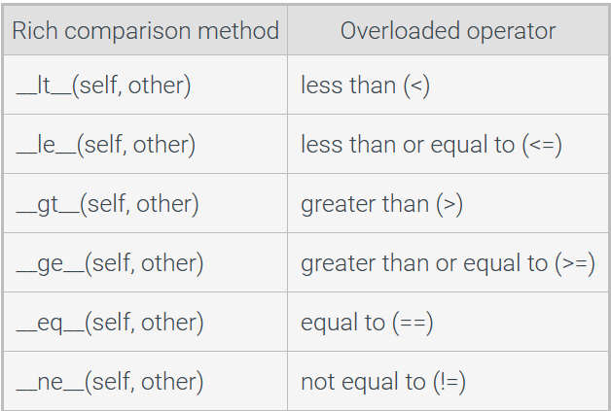

Slide 21
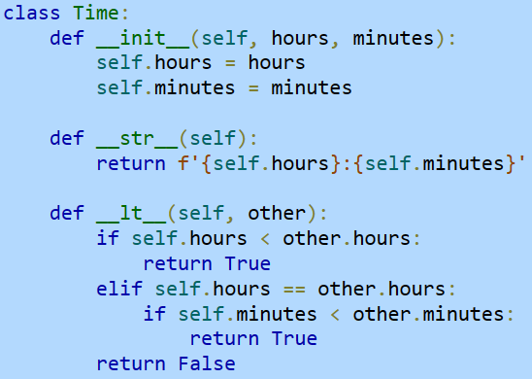
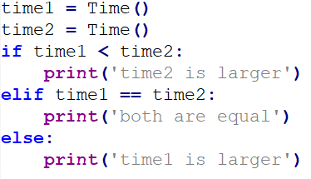

Slide 22
Exercise – ZyBook 9.8.1

